Slide 1
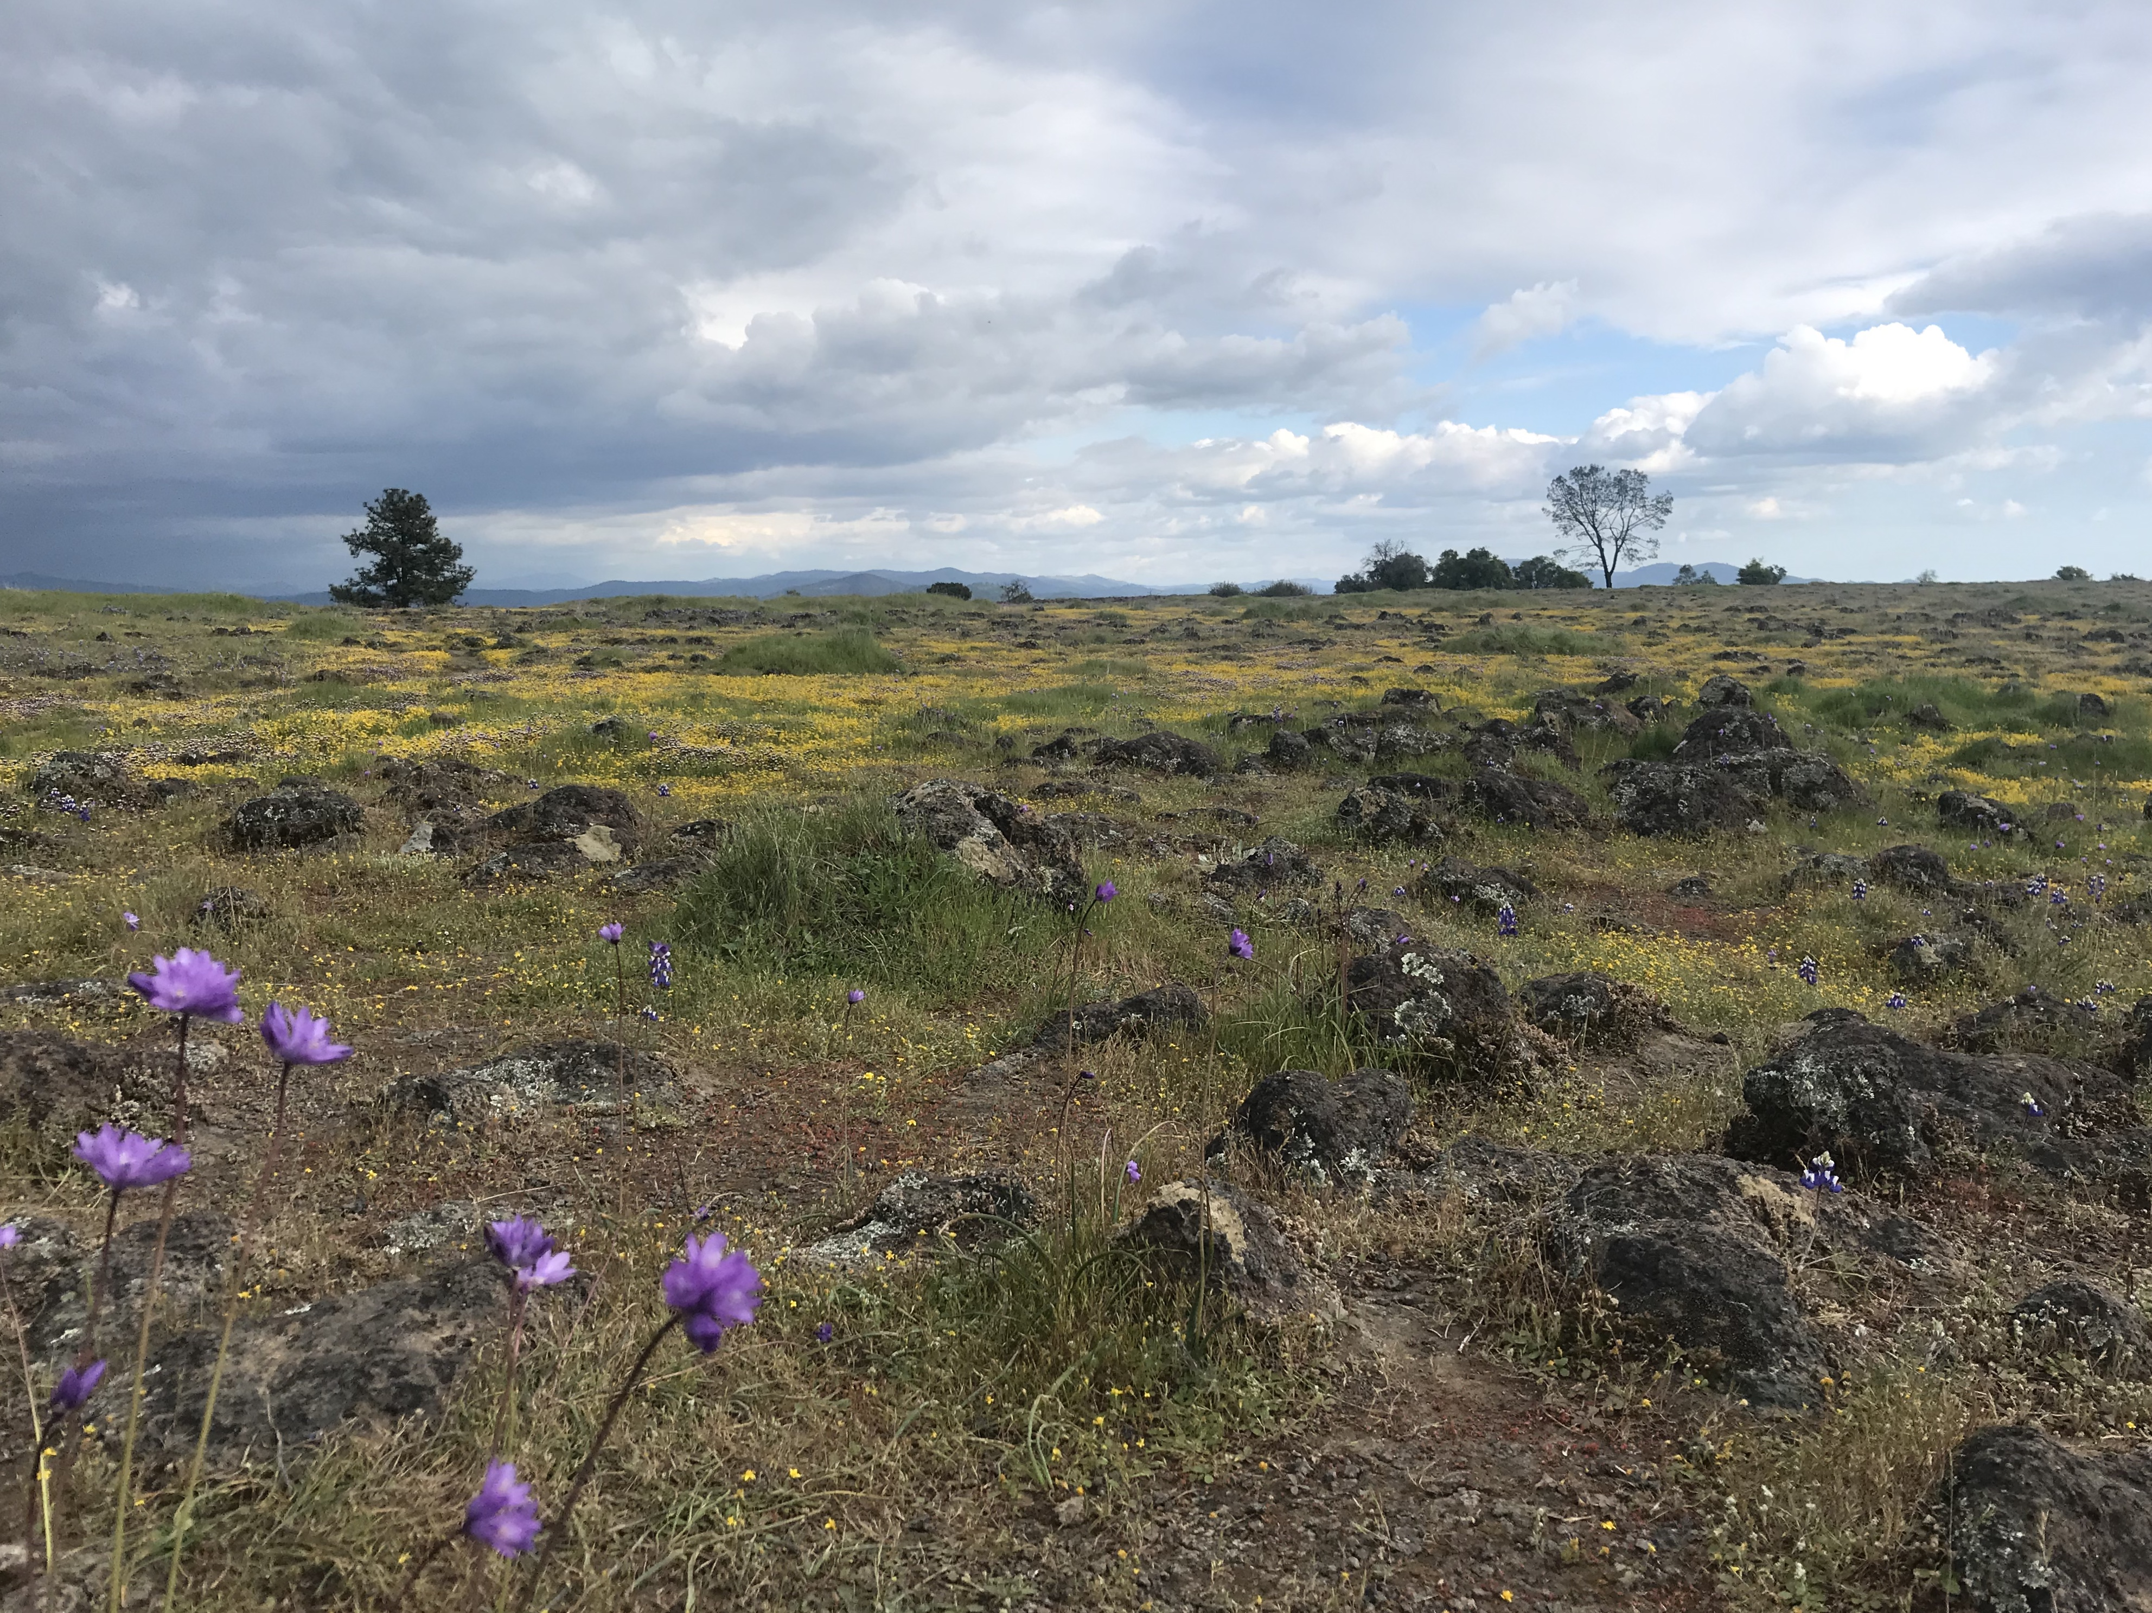


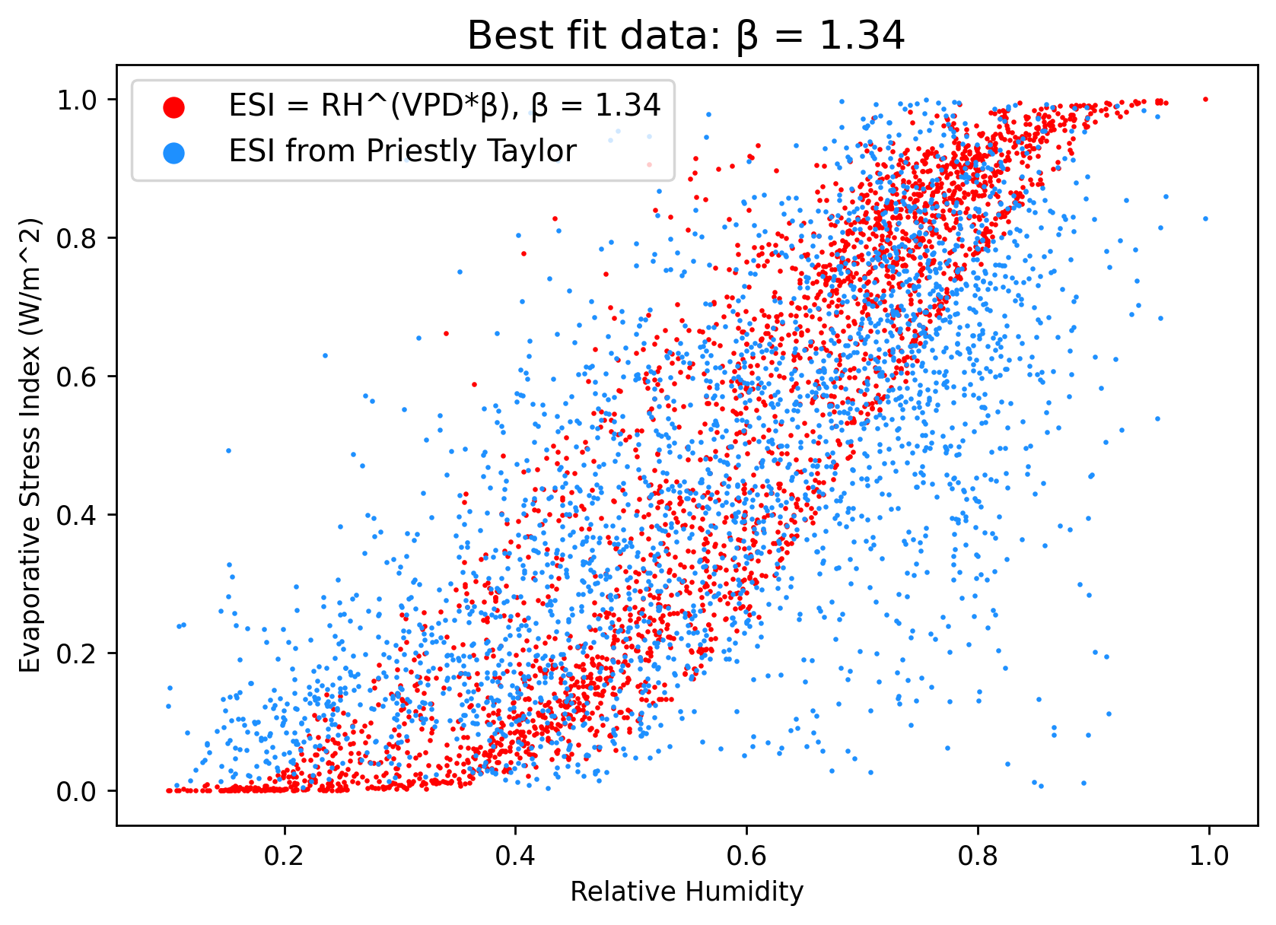
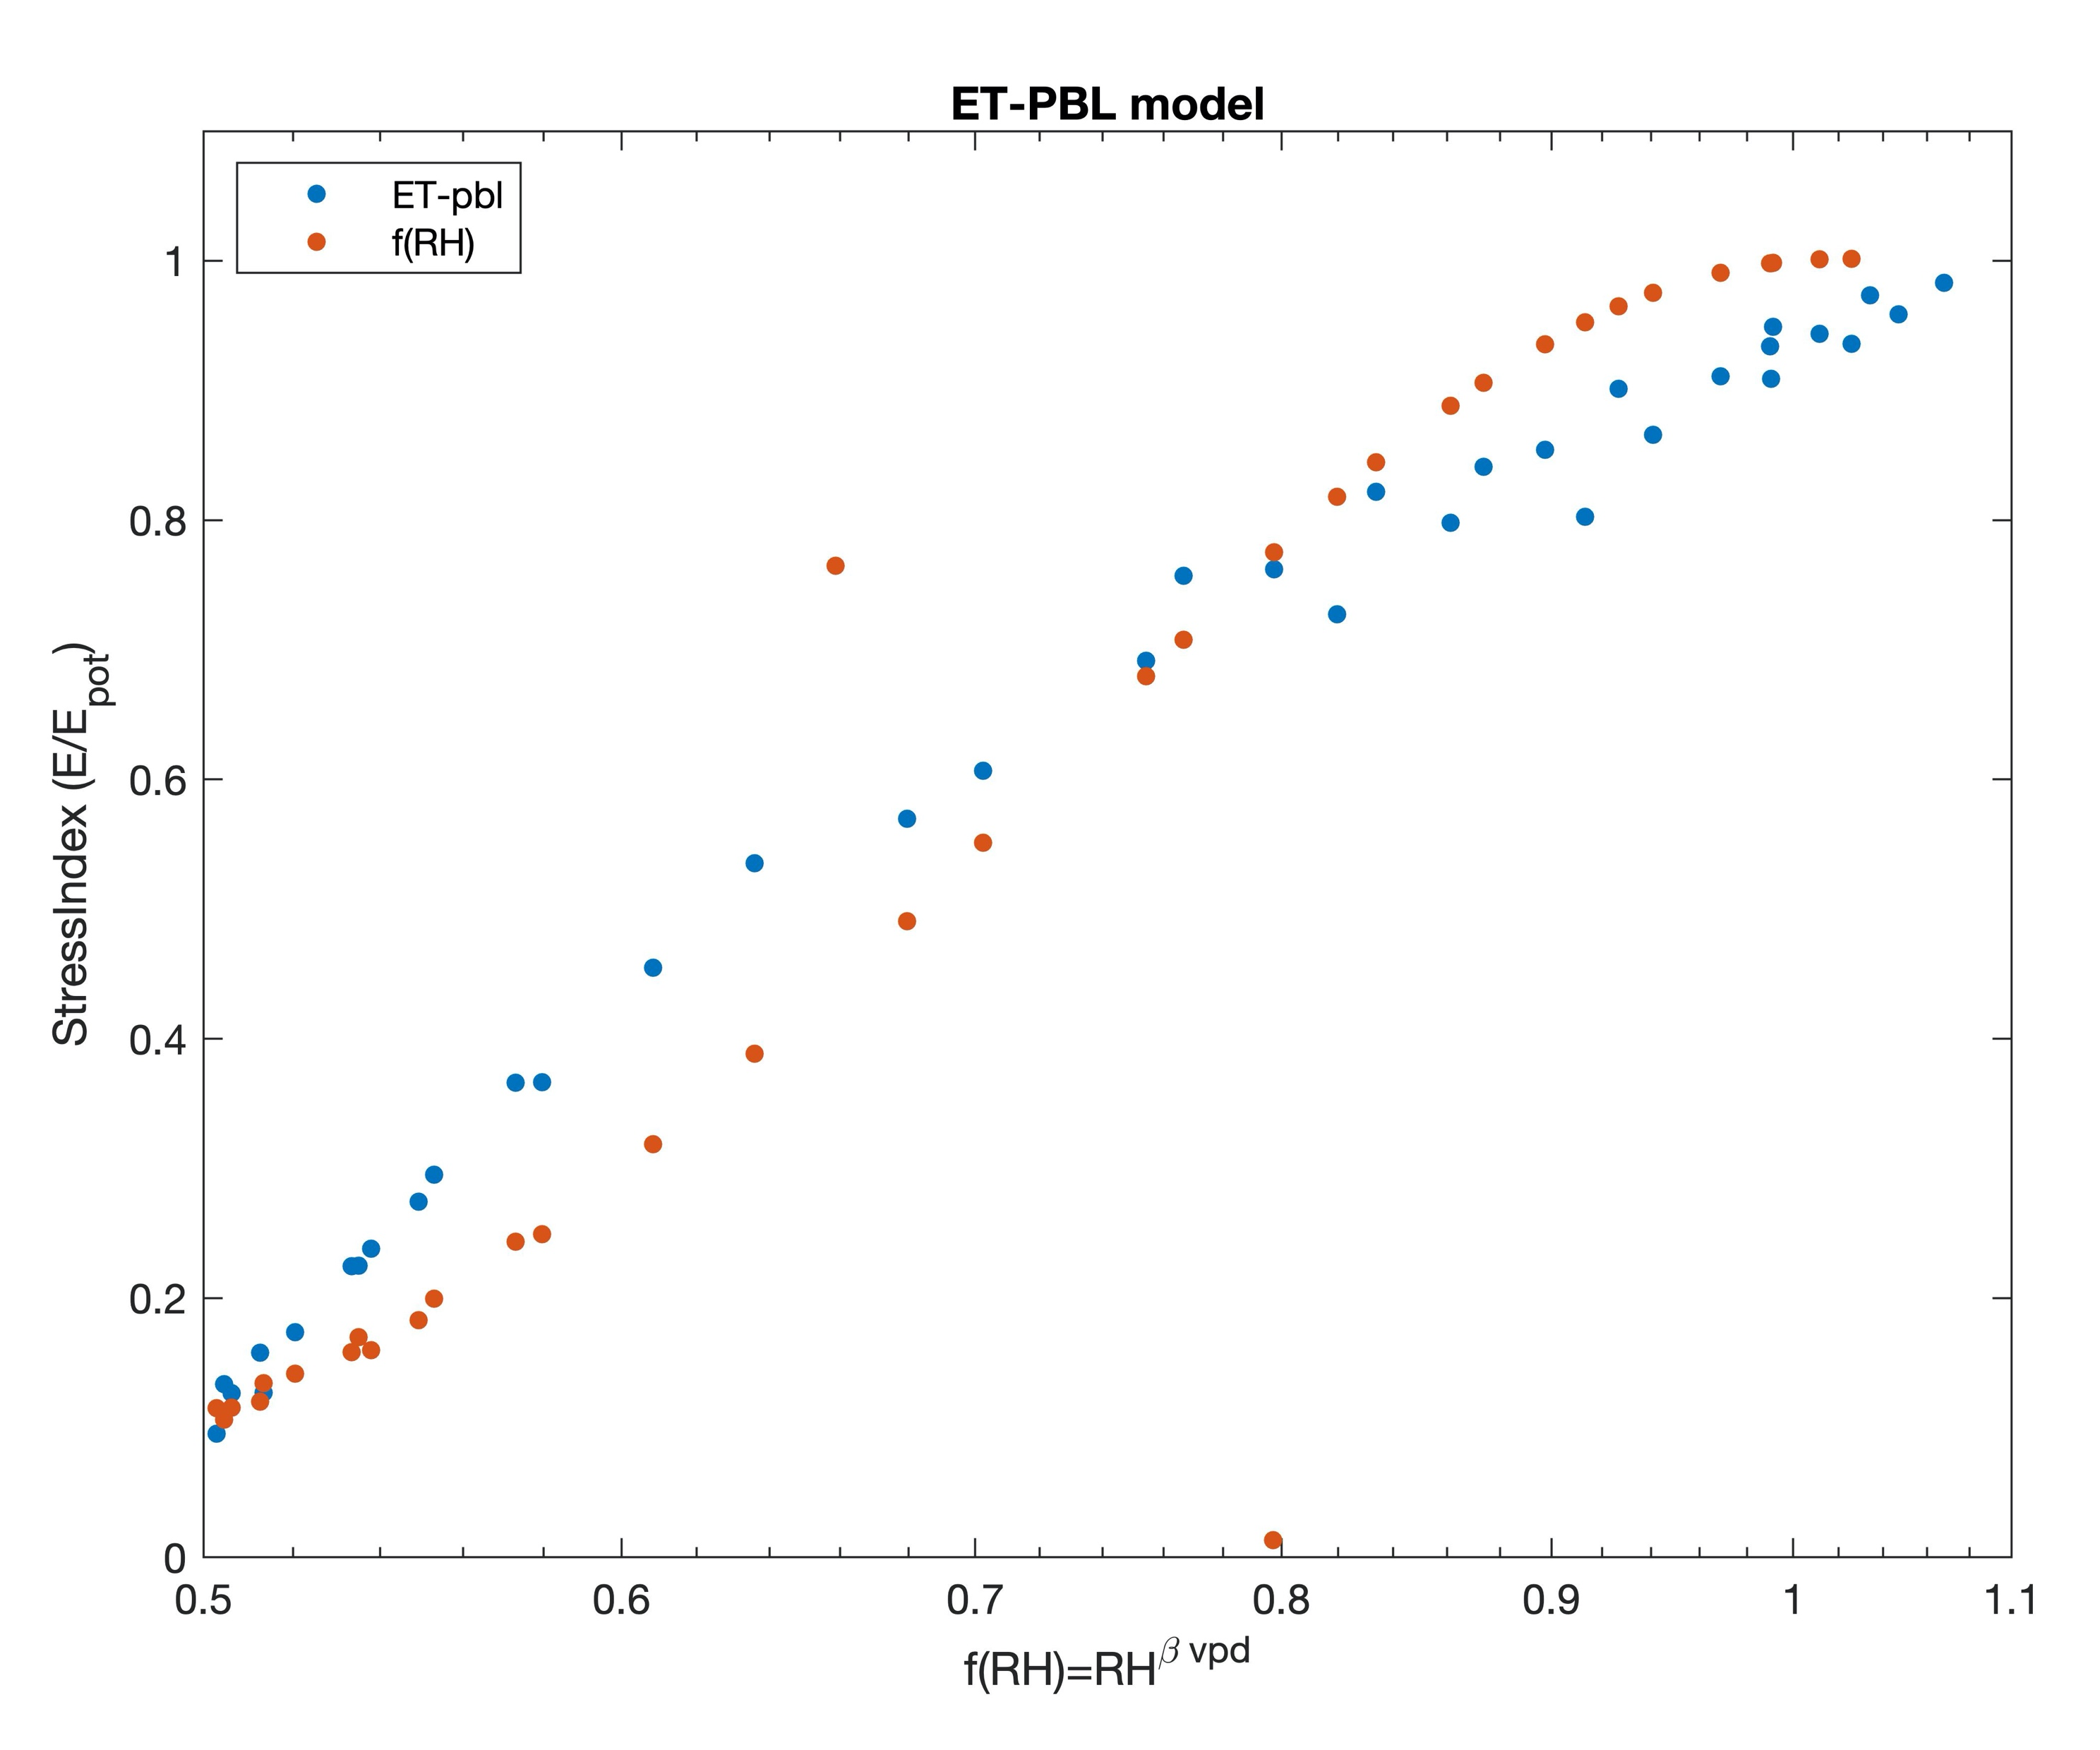

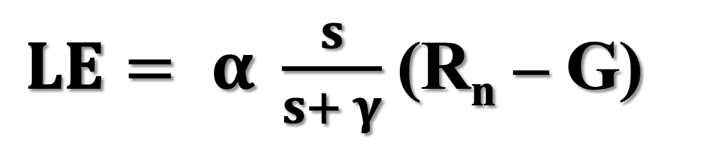
Evaluation of a simple parameterization for the evaporative stress index
Nicole Keeney¹ & Dennis Baldocchi²
¹Department of Earth and Planetary Sciences, University of California, Berkeley
²Department of Environmental Science, Policy, and Management, University of California, Berkeley
Abstract
Preliminary Results
Materials & Methods
The evaporative stress index (ESI) describes variation in evapotranspiration and provides an indicator of soil moisture and drought. We evaluate a simple parameterization of ESI proposed in Fisher et al. (2008) that is reliant only on relative humidity, vapor pressure deficit, and a scalar beta value, allowing for calculation of ESI using atmospheric variables that can be measured from space. Evaluations of the ESI parameterization using both a planetary boundary layer model and eddy covariance tower data from FLUXNET 2015 indicate that the parameterization is a good approximation of ESI, particularly when the scalar beta term is calculated by ecotype. Our analysis reflects that biosphere-atmosphere interactions, which directly impact vapor pressure deficit and relative humidity, can provide a simple but effective measure of soil moisture and water stress.
Evaluation by ecotype, using FLUXNET 2015 data
Data
Eddy covariance data from FLUXNET 2015, averaged monthly
Methods
The Fisher ESI parameterization is evaluated against the Priestley-Taylor model for evapotranspiration, which relies on knowledge about the energy balance of the system.
Evaluation by ecotype, using FLUXNET 2015 data:
Priestley Taylor evapotranspiration is computed using energy fluxes and atmospheric data from FLUXNET 2015.
The scalar beta value is computed for each ecotype, and then used to calculate ESI with the Fisher parameterization.
Evaluation using a planetary boundary layer (PBL) model:
Energy fluxes simulated in a PBL model are used to compute Priestley Taylor evapotranspiration against different beta values
Code
Code for this project is documented and easily accessible online as a Jupyter Book hosted by GitHub.
https://nicolejkeeney.github.io/fluxnet_ESI/home.html
Main takeaway: ESI parameterization is a good fit for arid, non-forested ecosystems
Ecotypes with best fit (smallest sum of square residuals) to Priestley Taylor are used to compute a best fit β value
β = 1.34
LE: evapotranspiration
α: Priestley-Taylor constant
s: slope of the saturation vapor pressure curve
γ: psychrometric constant
R_{n}: net incoming radiation
G: soil heat flux
$LE= α \frac{s}{s+ γ}$(R_{n} – G)
Evaluation using a planetary boundary layer model
Background
Main takeaway: ESI parametrization is a good fit for energy balance ESI across a range of simulated conditions and β values
Graph shows Priestley Taylor ESI (ET-PBL) and ESI parameterization (f(RH)) approximately linear, indicating good fit
Arbitrary β chosen for simulation
Gas exchange through stomata impacts the atmospheric moisture budget of the environment as water vapor is exchanged between plants and the planetary boundary layer during evapotranspiration. Stomata close during dry conditions, inhibiting evapotranspiration (and therefore water vapor exchange) and changing the vapor pressure deficit and humidity of the surrounding atmosphere.
Fisher et al. (2008) proposes a simple parameterization of the soil moisture constraint (f_{SM}) built upon the biometeorology principles above. f_{SM} is used in conjunction with other environmental and atmospheric variables to solve for total evapotranspiration.
Here we show that this soil moisture constraint function can be used as a proxy for the evaporative stress index. This technique greatly simplifies computation of ESI.
Conclusion
Acknowledgements
$$f_{SM}={RH}^{VPD∗β}$$
VPD: vapor pressure deficit
RH: relative humidity
β: scalar defining sensitivity to VPD
Vapor pressure deficit and relative humidity, along with a scalar β term, can be used as an accurate measure of soil moisture for arid, non-forested ecosystems such as savannahs and grasslands.
Further evolution of this project will involve more rigorous statistical analysis using Akaike information criterion.
This poster highlights preliminary work for the author’s undergraduate honors thesis in Atmospheric Sciences, advised by Dennis Baldocchi. Many thanks to Dennis for his continued help and guidance– this work would not be possible without him!
References:
Joshua B. Fisher, 2008, Global estimates of the land-atmosphere water flux based on monthly AVHRR and ISLSCP-II data, validated at 16 FLUXNET sites (Journal Article): Remote Sensing of Environment.

